Slide 1
Data Pipelines
Sunil Bhutada

Slide 2
Agenda
Introduction
Modes of Data Flow
Modern Data Stack
Data Pipelines
Data Pipeline Architecture
Data Pipeline Implementation
Data Pipeline - Tools / Platforms

Slide 3
Introduction

Slide 4
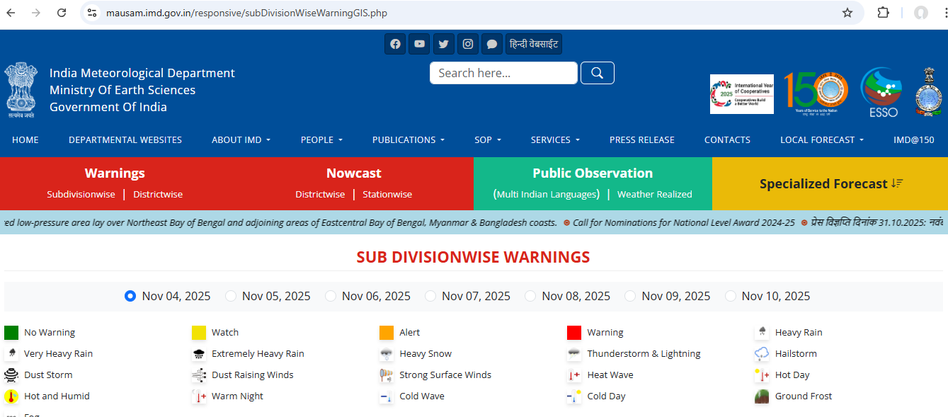
Have you seen this?

Slide 5
IMD source systems
Why you need seamless flow of information?
This massive system now can say
Do you know from how many systems IMD collects data? Any guess?
Per https://mausam.imd.gov.in/event/evolution.pdf
806 Automatic Weather Stations (AWS)
1,382 Automatic Rain Gauges (ARG)
5,896 District-wise Rainfall Monitoring Scheme (DRMS) stations
200 Agro-Automated Weather Stations (Agro-AWS) and other Agromet observatories
56 Radiosonde/Radiowind (RS/RW) stations for upper-air observations
39 Doppler Weather Radars (DWRs)
Two geostationary satellites (INSAT-3D and INSAT-3DR), which also relay data from the AWS/ARG network
Other specialized networks for monitoring ozone (multiple stations), precipitation chemistry (11 stations), aerosols (12 locations), black carbon (16 stations), and lightning (83 sensors).
Numerous manual surface observatories (around 530, some of which are non-departmental).
Other systems like High Wind Speed Recorders, Runway Visual Range (RVR) systems at airports, and the System for Air Quality Forecasting And Research (SAFAR) stations in major cities.
Can we do it manually multiple times everyday?

Slide 6
Why?
Is it humanly possible to feed data?
Why to do you need a data pipeline then?
Well-designed pipeline is critical for handling the “5 V’s” of big data (volume, velocity, variety, veracity, value) while remaining efficient to maintain.
Now is this reason justified for the previous example IMD?
At the heart of any data pipeline, it’s fundamentally about data flow — how data moves from one system to another, often through a series of processing, transformation, and storage stages.

Slide 7
Modes of Data Flow

Slide 8
Introduction
In our previous sessions we had seen data flowing from one system to another, do you remember?
2
Let us expand the same in this section
Modes of DataFlow
Databases
Services
Message Passing

Slide 9
Modes of Data Flow - Through Databases

Slide 10
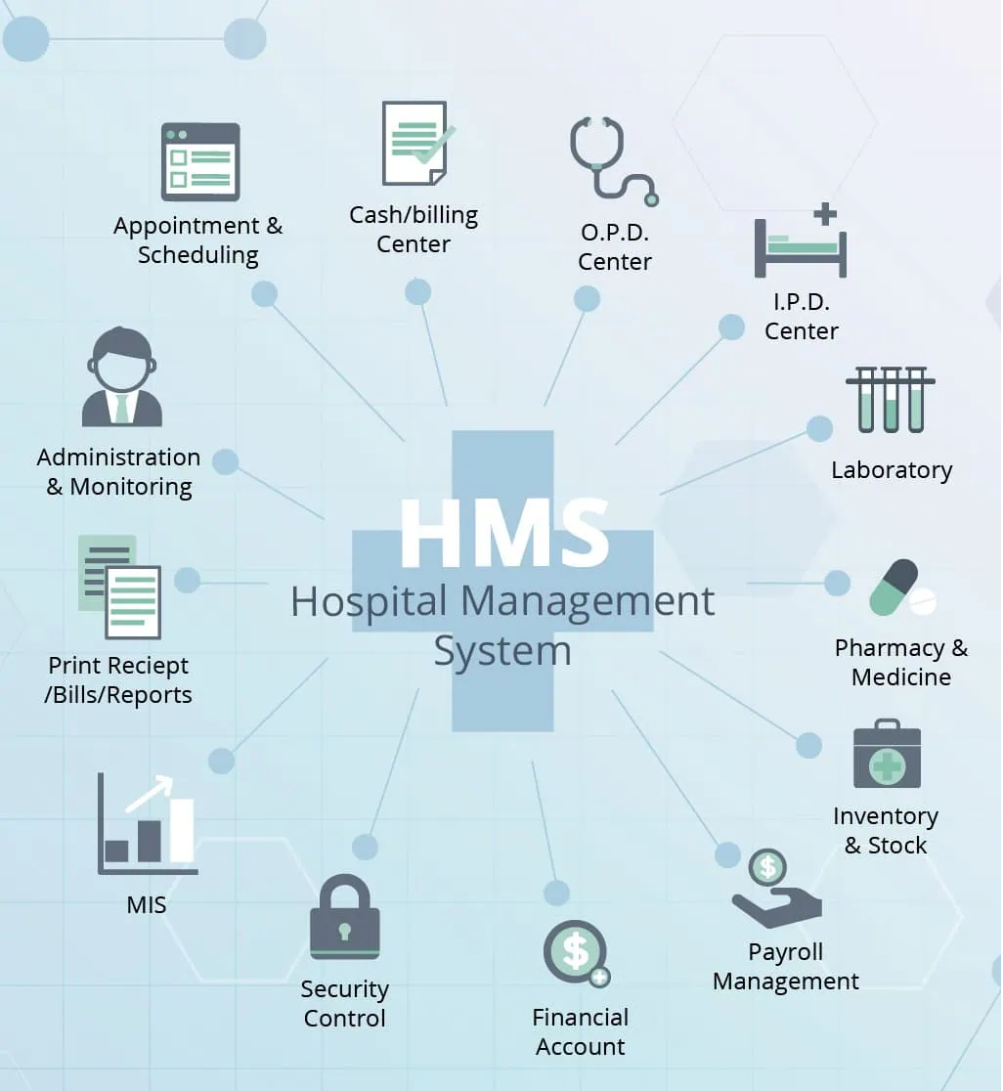
Example
Data exchange through databases, can you share an example which comes to your mind immediately?
Hospital management system
These days all hospitals are automated for information flow
Have you seen these days though doctors give a printout, in the pharmacy the medicines are distributed based on the online prescription?
The application used by doctor and the pharmacist are different. So how the data is transferred or flown from one application to other?
Image Source

Slide 11



Illustration
HMS DB
Doctor’s application
Pharmacist’s application
Pharmacist
Doctor
Patient’s Mobile app
Patient visits doctor
Gets Medicine
Additionally view the doctor’s prescription on the mobile app
Patient

Slide 12
Scenarios
Scenario 1: The process that writes to the database encodes the data, and the process that reads from the database decodes it
DB
Application / Process 1
Application / Process 2
Encodes
Decodes
Scenario 2: A single process accessing the database, in which case the reader is simply a later version of the same process. Backward compatibility is clearly necessary here, otherwise won’t be able to decode what was previously wrote
Application / Process – V1.01
DB
Application / Process – V1.02
Scenario 3: Several different processes to be accessing a database at the same time. For example, several different applications or services, or several instances of the same service
Application / Process – 1
DB
Application / Process – 4
Application / Process – 2
Application / Process – 3

Slide 13
Points to Remember
In a changing environment
Likely that some processes accessing the database will be running newer code and some will be running older code
A new version is currently being deployed in a rolling upgrade, so some instances have been updated, while others haven’t yet!
Means that a value in the database may be written by a newer version of the code, and subsequently read by an older version of the code that is still running
Forward Compatibility is also often required for databases
New System
V1
V2
V3
V4
V5
Reverse / Backward Compatibility
Forward / Future Compatibility

Slide 14
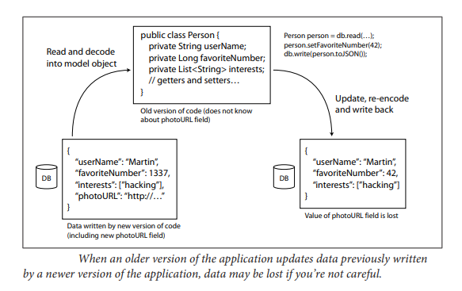
Changes to data
If a field is added to a record schema, and the newer code writes a value for that new field to the database. Subsequently, an older version of the code (which doesn’t yet know about the new field) reads the record, updates it, and writes it back
In this situation, the desirable behavior is usually for the old code to keep the new field intact, even though it couldn’t be interpreted
The encoding formats support such preservation of unknown fields, but sometimes need to take care at an application level

Slide 15
Points to Remember
Different values written at different times
A Database generally allows any value to be updated at any time
Means within a single database may have some values that were written five milliseconds ago, and some values that were written five years ago
Data outlives code
When deploy a new version of your application, may entirely replace the old version with the new version within a few minutes
Same is not true of database contents: the five-year-old data will still be there

Slide 16
Points to Remember
Schema Evolution
Rewriting (migrating) data to a new schema is certainly possible, but it’s an expensive thing to do on a large dataset, so mostly avoided
Simple schema changes, such as adding a new column with a null default value, without rewriting existing data
Schema evolution thus allows the entire database to appear as if it was encoded with a single schema, even though the underlying storage may contain records encoded with various historical versions of the schema
Archival Storage
Snapshot of database can be taken from time to time, say for backup purposes or for loading into a data warehouse
Data dump will typically be encoded using the latest schema, even if the original encoding in the source database contained a mixture of schema versions from different eras
Copying the data anyway, might as well encode the copy of the data consistently

Slide 17
Modes of Data Flow - Through Services

Slide 18
Introduction
Processes that need to communicate over a network, there are a few different ways of arranging that communication
We are going to discuss about
Client Server Architecture
Service Oriented Architecture(SOA)
Microservices Architecture
Web Services
Remote Procedure Calls

Slide 19
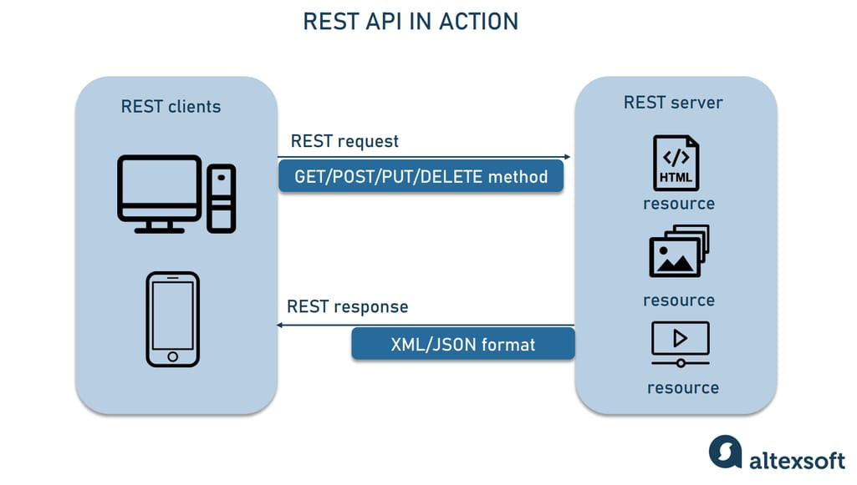
Client Server Architecture
Web Clients
Clients (web browsers) make requests to web servers, making GET requests to download HTML, CSS, JavaScript, images etc. or making POST requests to submit data to the server
The API consists of a standardized set of protocols and data formats (HTTP, URLs, SSL/TLS, HTML, etc.)
Because web browsers, web servers and website authors mostly agree on these standards, can use any web browser to access any website
Image Source
The servers expose an API over the network, and the clients can connect to the servers to make requests to that API
The API exposed by the server is known as a service

Slide 20
Client Server Architecture
Other Clients
A native app running on a mobile device or a desktop computer can also make network requests to a server
A client-side JavaScript application running inside a web browser can use XMLHttpRequest to become a HTTP client (aka Ajax)
The server’s response is typically not HTML for displaying to a human, but rather data in an encoding that is convenient for further processing by the client-side application code (such as JSON)
API is implemented on top of HTTP is application-specific Client and server need to agree on the details of that API

Slide 21
Services Oriented Architecture
Server can itself be a client to another service
Often used to decompose a large application into smaller services by area of functionality, such that one service makes a request to another when it requires some functionality or data from that other service
A key design goal is to make the application easier to change and maintain by making services independently deployable and evolvable. For example, each service should be owned by one team, and that team should be able to release new versions of the service frequently without having to coordinate with other teams
Should expect old and new versions of servers and clients to be running at the same time
Data encoding used by servers and clients must be compatible across versions of the service API

Slide 22
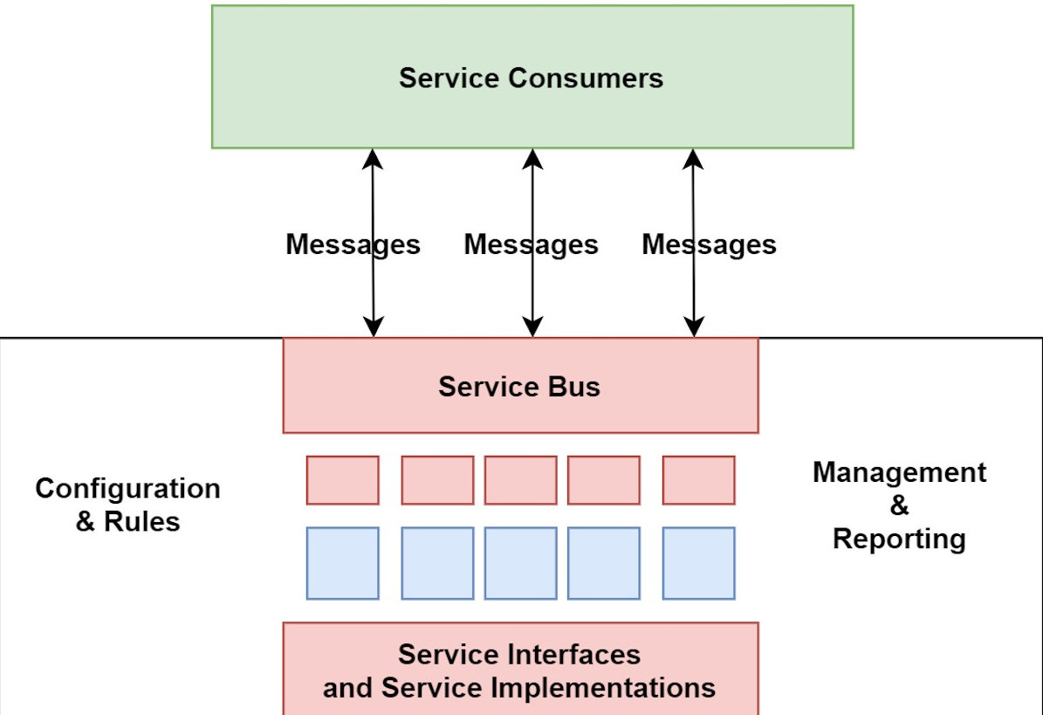
Services Oriented Architecture
Image Source

Slide 23
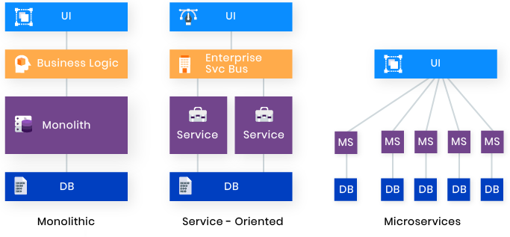
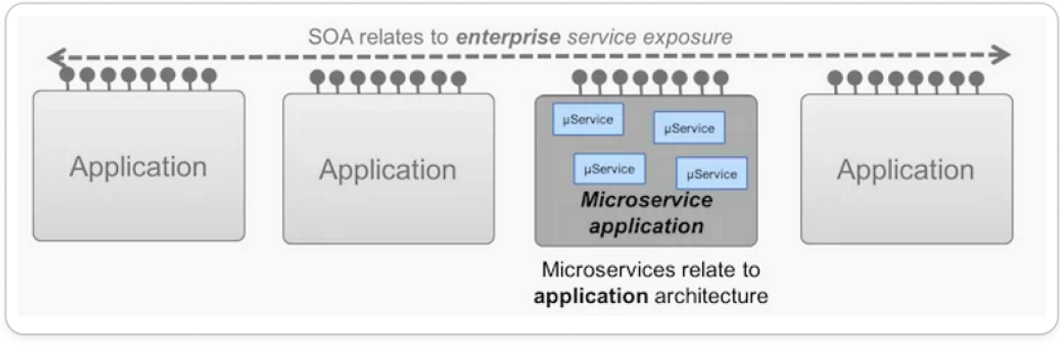
SOA - Microservices
Microservices is an architectural style evolved from SOA.
Both are distributed architectures and both offer a decoupled paradigm.
Whereas service-oriented architecture is heavier on infrastructure, microservices offers a more flexible, lightweight development style.
Image Source

Slide 24
SOA vs Webservices
SOA and web services are frequently conflated, but they are not the same thing.
SOA is an architecture that allows developers to combine multiple application services into a larger, composite service.
SOA can be implemented using SOAP-based web services or REST APIs, or sometimes a combination of both.
It’s important to understand that in SOA, a service is any remotely available resource that can respond to requests. A web service is implemented using specific protocols.

Slide 25
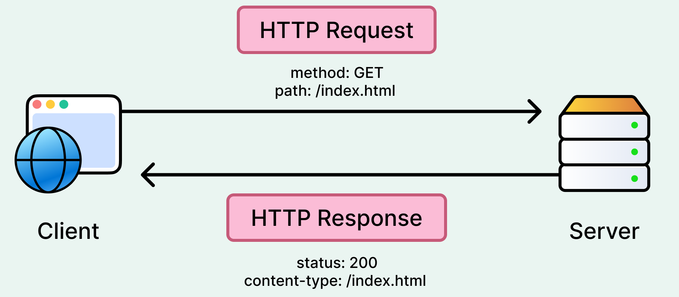
Webservices
HTTP:
HTTP, which stands for Hypertext Transfer Protocol, is the set of rules that allows web browsers to communicate with web servers to load webpages.
When you visit a website, your browser sends an HTTP request to the server, which then sends back the data needed to display the page, such as text, images, and other files.
Image Source
Two popular approaches: REST and SOAP

Slide 26
Webservices - REST
Representational State Transfer
REST is not a protocol, but rather a design philosophy that builds upon the principles of HTTP
Emphasizes simple data formats, using URLs for identifying resources, and using HTTP features for cache control, authentication, and content type negotiation
Gaining popularity compared to SOAP, at least in the context of cross-organizational service integration and is often associated with micro services
An API designed according to the principles of REST is called RESTful
Image Source
Good for experimentation and debugging (can simply make requests to it using a web browser or the command-line tool curl)
Supported by all main stream programming languages and platforms
A vast ecosystem of tools(servers, caches, load balancers, proxies, firewalls, monitoring, debugging tools, testing)

Slide 27
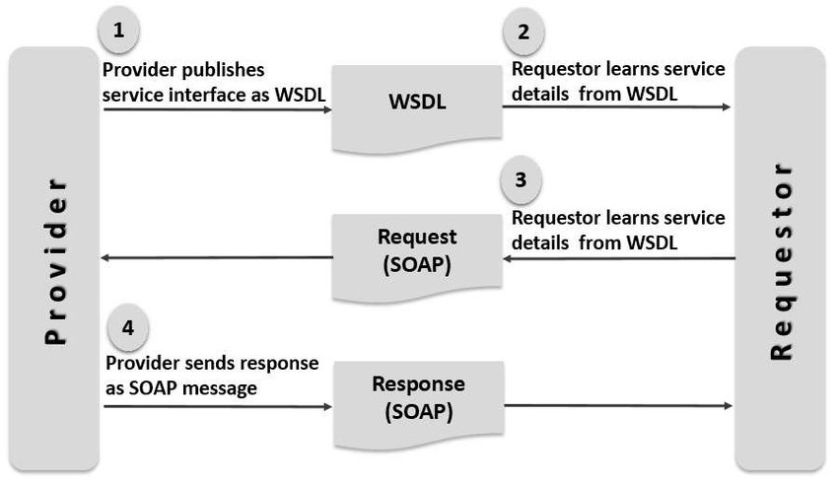
Webservices - SOAP
Instead comes with a sprawling and complex multitude of related standards (the web service framework, known as WS-*)
The API of a SOAP web service is described using an XML-based language called WSDL
As WSDL is not designed to be human-readable, and as SOAP messages are often too complex to construct manually, users of SOAP rely heavily on tool support, code generation and IDEs
Although SOAP is still used in many large enterprises, it has fallen out of favor in most smaller companies.
Image Source
Single Object Access Protocol
SOAP is an XML-based protocol for making network
API requests
Most commonly used over HTTP, it aims to be independent from HTTP and avoids using most HTTP features

Slide 28
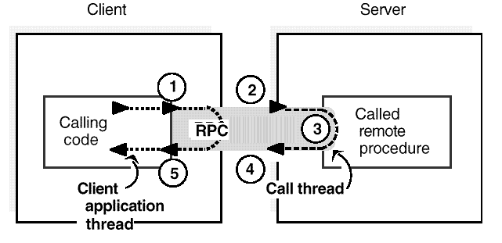
Remote Procedure Calls
RPC tries to make a request to a remote network service look the same as calling a function or method in programming language, within the same process (aka location transparency)
Although this seems convenient at first, the approach is fundamentally flawed . No point trying to make a remote service look too much like a local object in programming language, because it’s a fundamentally different thing
Image Source

Slide 29
Remote Procedure Calls – Current Directions
RPC isn’t going away!
Various RPC frameworks have been built on top of all the encodings:
Thrift and Avro come with RPC support included
gRPC is a RPC implementation using Protocol Buffers
New generation of RPC frameworks is more explicit about the fact that a remote request is different from a local function call
Also provide service discovery — that is, allowing a client to find out at which IP address and port number it can find a particular service
Custom RPC protocols with a binary encoding format can achieve better performance than something generic like JSON over REST
Focus of RPC frameworks is on requests between services owned by the same organization, typically within the same datacenter

Slide 30
Modes of Data Flow - Through Message Passing

Slide 31
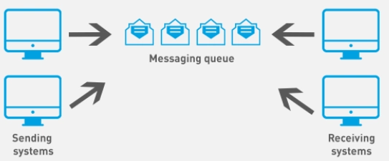
Introduction
Image Source
Asynchronous message-passing systems, which are somewhere between RPC and databases
Similar to RPC in that a client’s request (usually called a message) is delivered to another process with low latency
Similar to databases in that the message is not sent via a direct network connection, but goes via an intermediary called a message broker which stores the message temporarily
Also called a message queue or message-oriented middleware

Slide 32
Message Brokers
Landscape
In past, dominated by commercial enterprise software by companies such as TIBCO, IBM WebSphere, and webMethods.
More recently, open source implementations such as RabbitMQ, ActiveMQ, HornetQ, NATS and Apache Kafka have become popular
Working
One process sends a message to a named queue or topic
Broker ensures that the message is delivered to one or more consumers or subscribers of that queue or topic
Can be many producers and many consumers on the same topic
Message brokers typically don’t enforce any particular data model
Message is just a sequence of bytes, with some metadata, so can use any encoding format
If the encoding is backward and forward compatible, have the greatest flexibility to change publishers and consumers independently, and deploy them in any order

Slide 33
Message broker over direct RPC
Can act as a buffer if the recipient is unavailable or overloaded, and thus improve system reliability
Can automatically redeliver messages to a process that crashed, and thus prevent messages from being lost
Avoids the sender needing to know the IP address and port number of the recipient
Allows one message to be sent to several recipients
Logically decouples the sender from the recipient (the sender just publishes messages and doesn’t care who consumes them)
Message-passing communication is usually one-way
Sender normally doesn’t expect to receive a reply to its messages
Possible for a process to send a response, but this would usually be done on a separate channel
This is what makes it asynchronous: the sender doesn’t wait for the message to be delivered, but simply sends it and then forgets about it.

Slide 34
Modern Data Stack

Slide 35
Traditional/Legacy Data Stack(TDS) -Problems
Long turn-around time to untangle and set up infrastructure
Companies making use of on-premise infrastructure are responsible for all the costs associated with it
The army of engineers required to keep everything maintained and running smoothly.
As setup is so deeply interconnected, what may seem like a minor change might break other parts of the system
Finding the exact logical coupling between the systems requires a lot of work-hours to analyze before any improvements can be made to the existing landscape
Expensive journey to insights
A lot of the report generation is manually done, especially when the data is coming from different sources
The report is manually generated, manually cleaned, and manually transferred to Excel
Leads to errors being made, time being taken away from other business-critical tasks, and the inability to scale.
Analysts are unable to efficiently perform their roles due to the complex landscape
Source: neptune

Slide 36
Traditional/Legacy Data Stack – Problems - contd
Slow response to new information
As the company grows, so does its data and computational power needs
Very costly in terms of resources and time when it comes to scaling out (expanding) on-premises infrastructure
Leads to a limit in how much computational power there is to analyze data
Data pipelines can take hours to complete, a problem that is compounded as the organization grows
A TDS requires slow ETL (Extract, Transform, Load) operations before newly ingested data can conform to the rest of the data model
A new data update can take weeks and many hours of refactoring before insights appear
By the time the data is ready, the organization is unable to act in time resulting in missed opportunities.
Summary
Rely on rigid, on-premises infrastructure that can struggle with scalability, flexibility and real-time processing.
Source: neptune

Slide 37
What is Modern Data Stack?
Refers to integrated, cloud-based tools and technologies that enable the collection , ingestion , storage , cleaning, transformation, analysis and governance of data
Offers a cloud-native, modular solution designed to streamline automation, optimize costs and accelerate insights
Empowers self-service analytics and artificial intelligence (AI) applications that many companies rely on today.
Think of MDS as the assembly line of digital operations—each component plays a role in moving data seamlessly from collection to analysis
By automating and scaling workflows, MDS ensures that organizations can process, store and use data with precision, driving better decision-making and innovation.

Slide 38
TDS vs MDS
 | Traditional Data Stack | Modern Data Stack
Infrastructure | Relies on physical servers | Cloud native
Scalability | Requires manual scaling | Scales dynamically with demand
Integration | Relies on custom workflows | Automates data ingestion
Flexibility | Monolithic | Modular, enabling seamless tool integration
Analytics | Supports batch reporting | Offers real-time insights and interactive dashboards.
Cost | Involves significant upfront investment | Uses pay-as-you-go models.

Slide 39
MDS - Key Characteristics
Enable self-service for a diverse range of users
Easily discover and analyze data within the platform
Understand the context associated with data, such as column descriptions, history and lineage
Derive insights from data with minimal dependencies on the data or IT team
Enable "agile" data management
Availability: Data is already available in a data lake or warehouse. Modern data lakes and warehouses separate storage and compute, which makes it possible to store large amounts of data for relatively cheap.
Elasticity: Compute is based on a cloud platform, which allows for elasticity and auto-scalability. For example, if end users consume the most data and analytics on Friday afternoons, it should be possible to auto-scale processing power on Friday afternoon to give users a great experience and then scale down within a few hours.

Slide 40
MDS - Key Characteristics - contd
Flexible, fast set-up, and pay-as-you-go
Easy to set up – no lengthy sales process, demo calls, and implementation cycles. Just login, pay via credit card, and go!
Pay as you go – no up-front payments and million dollar licensing fees. The "modern" stack is all about putting power in the hands of the consumer, i.e. paying only for what you use
Plug and play – the modern data stack will continue to evolve and innovate, and the best of breed tools do not enforce "lock in" like tools in the legacy era, and are instead built on open standards & APIs allowing easy integration with the rest of the stack

Slide 41
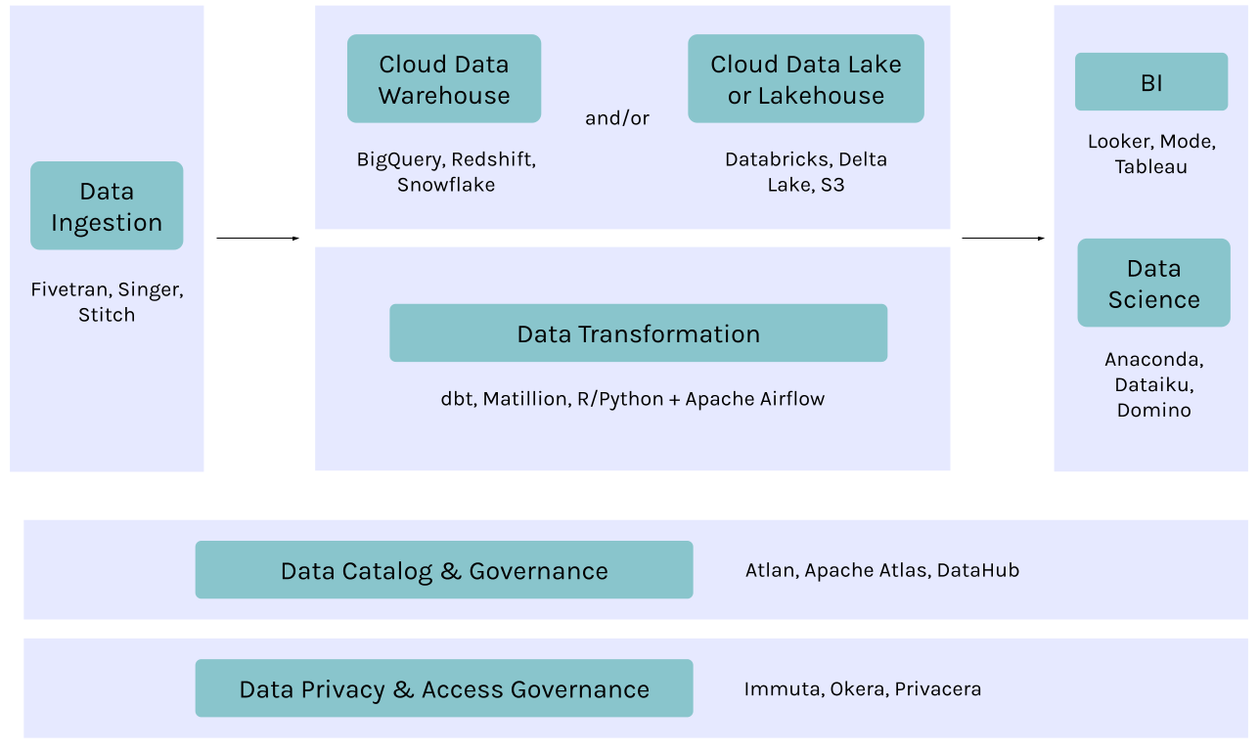
Key Building Blocks
Source: atlan

Slide 42
Modern Data Tools
Modern Data Ingestion
Data ingestion is likely where your efforts to build out a modern data platform get started
i.e. How do you bring data from a variety of different data sources and ingest it into your core data storage layer?
The majority of data pipelines capture data in batch, using SQL queries or extract routines, but this is changing
Many companies now prefer a streaming-first architecture that captures and processes data in real time in a continuous stream
Streaming tools use change data capture, replication, and/or publish/subscribe messaging systems to capture events as they happen, move them into the data environment, and analyze them.

Slide 43
Modern data tools - contd
Modern data storage and processing
The data storage and processing layer is fundamental to the modern data platform. While this architecture is evolving, we typically see 3 kinds of tools or frameworks:
Data Warehouses
These are generally the system of choice for analysts since they optimize compute and processing speed.
Data Lakes
A data lake architecture refers to data being stored on an object storage, coupled with tools to process the data
These cheap storage systems are often used to store vast amounts of raw or even unstructured data.
Data Lakehouses
Convergence of data warehouses and lakes
Helps to unify the siloed systems
A system design that combines the data management features such as ACID transactions and change data capture from a data warehouse with the low-cost storage of a data lake

Slide 44
Modern data tools - contd
Modern data transformation - Core implementations
Native SQL
For companies with data warehouse–first architectures, tools that leverage native SQL for transformation have emerged as the top choice for data transformation.
Orchestration Engine
Orchestration Engine coupled with custom transformation in a programming language
Modern business intelligence and analytics
BI dashboards have been around for ages, but the latest breed of BI and analytics tools are built to fit within a larger modern data platform.
These are generally more self-service platforms that allow users to explore data, rather than just consuming graphs and charts.

Slide 45
Modern data tools - contd
Modern data catalogs and governance
While the modern data platform is great in some areas (super fast, easy to scale up, little overhead), it struggles with bringing discovery, trust and context to data.
As metadata itself becomes big data, we’re in the midst of a leap forward in metadata management
Modern data privacy and access governance
A major challenge is to be able to manage privacy controls and access governance across your entire stack.
Tools that can act as an entitlement engine to apply privacy and security policies across the data stack.
Other tools
Real-time data processing tools
Data science tools
Event collectors
Data quality tools

Slide 46
Modern data tools – Summary
Component | Tools
Data ingestion | SAAS tools: Fivetran, Hevo Data, Stitch Open-source tools: Singer, StreamSets Custom data ingestion pipelines built on orchestration engines like Airflow
Data Storage and Processing | Data warehouses : BigQuery, Redshift, , Snowflake. Data lakes : Data storage: Amazon S3, Azure Data Lake Storage Gen2, Google Cloud Storage Data processing engines: Databricks or Spark; Athena, Presto, or Starburst; Dremio Data LakeHouse: Databricks, Snowflake, and Google BigLake, Delta Lake, Apache Hudi, Apache Iceberg
Data Transformation | With data warehouses: dbt, Matillion With an orchestration engine: Apache Airflow + Python, R, or SQL
Business Intelligence & Analytics | Looker, Mode, Redash, Sigma, Sisense, Superset, and Tableau.

Slide 47
Modern data tools – Summary - Contd
Component | Tools
Data catalogs and governance | SAAS tools: Atlan Open-source tools: Apache Atlas, LinkedIn’s DataHub, Lyft’s Amundsen In-house tools: Airbnb’s Dataportal, Facebook’s Nemo, Uber’s Databook
Data privacy and access governance | SAAS services: Immuta, Okera, Privacera Open-source engines: Apache Ranger

Slide 48
Modern data tools – Summary - contd
Component | Tools
Real-time Data Processing | Real-time streaming pipelines: Confluent, Kafka Real-time analytics: Druid, Imply
Data Science | Preferred by data scientists: Jupyter Notebooks Other options: Dataiku, DataRobot, Domino, SageMaker
Event Collectors | Segment , Snowplow
Data Quality | Data profiling: This is getting engulfed by data catalog and governance tools like Atlan or open source profiling frameworks like Amazon Deequ. Unit testing: Frameworks like the open-source Great Expectations

Slide 49
Use Cases
AI-Powered Personalization
MDS allows businesses to deliver data-driven AI personalization. This personalization can help optimize user experiences across areas such as e-commerce, streaming platforms and software as a service (SaaS) applications. Using Apache Spark for real-time processing and Databricks for scalable analytics, data scientists can analyze customer preferences and engagement to improve recommendation engines and content delivery networks.
Customer Insights and Sales Optimization
Companies use MDS and SaaS analytics tools to track customer behavior and refine marketing strategies. Cloud platforms such as Snowflake and Looker generate real-time dashboards for categories such as purchase patterns and pricing optimization—all of which can help businesses boost conversion rates and
retention.

Slide 50
Data Pipeline

Slide 51
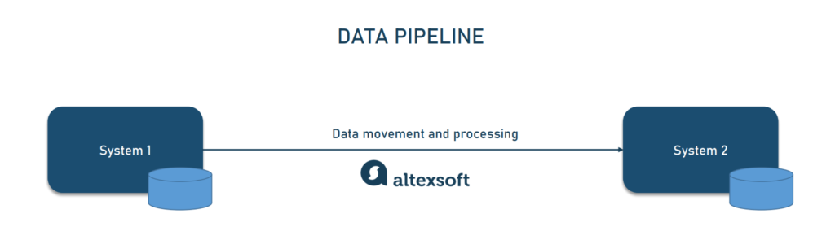
Re-Introduction
Series of steps that allow data from one system to move to become useful in another system particularly analytics, data science, or AI and machine learning systems
Works by pulling data from the source, applying rules for transformation and processing, then pushing data to its destination.

Slide 52
Origin
Emerged from the big data community
Data lakes created a feeding frenzy among developers, data scientists, and data analysts
Gained unfettered access for the first time
To a nearly limitless supply of raw data sourced
From a multiplicity of internal and external systems
Created a wide diversity of workflows and programs—or data pipelines—to process that data
(e.g., clean, filter, aggregate, move, load)
For a variety of purposes and use cases

Slide 53
Situation
Though data is a critical business asset most organizations still don’t have mature processes for converting data into insights that drive business value
The development of data and analytics pipelines, is still a handcrafted and largely non-repeatable process with minimal reuse, managed by individuals working in isolation with different tools and approaches
The result is
A plodding development environment that can’t keep pace with the demands of a data-driven business
An error-prone operational environment that is slow to respond to change requests
Drawing Swords
The lack of efficiency on the development side leads to a lack of effectiveness on the business side
Business and IT draw swords and go to war instead of partnering

Slide 54
Purpose
Lot of data out there!
Data pipelines transform raw data into data ready for analytics, applications, machine learning and AI systems
Keep data flowing to solve problems, inform decisions
Used to:
Deliver sales data to sales and marketing for customer 360
Link a global network of scientists and doctors to speed drug discovery
Recommend financial services to help a small business owner thrive
Track COVID-19 cases and inform community health decisions
Combine diverse sensor data with AI for predictive maintenance
With so much work to do, data pipelines can get pretty complicated pretty fast.

Slide 55
Benefits
Self-service Data
Can be created ad hoc by data scientists and business analysts unstick the IT bottleneck
Means when people have brilliant ideas, they can test them, fail fast, and innovate faster
Real-time Analytics and Applications
Real-time or near real-time functionality in consumer and business applications puts the pressure on data pipelines to deliver the right data, to the right place, right now
Streaming data pipelines deliver continuous data to real-time analytics and applications
Accelerate Cloud Migration and Adoption
Helps to expand cloud presence and migrate data to cloud platforms
Cloud computing helps to feed many new use cases at processing speeds, cost-effectiveness, and bursting capacity unheard of in traditional on-premises data centers
Teams can take advantage of rapid innovation happening on those cloud platforms such as
Natural language processing
Sentiment analysis
Image processing and more.

Slide 56
Challenges
Always Under Construction Data
Building and debugging data pipelines takes time
Have to align with the schema, set sources and destinations, check work, find errors, and back and forth until one can finally go live by which time the business requirements may have changed again
That's why many data engineers have such a backlog of work
Out of Order Data Pipelines
Even a small change to a row or a table can mean hours of rework, updating each stage in the pipeline, debugging, and then deploying the new data pipeline
Data pipelines often have to go offline to make updates or fixes
Unplanned changes can cause hidden breakages that take months of engineering time to uncover and fix
These unexpected, unplanned, and unrelenting changes are referred to as “data drift”.
Build It and They Will Come
Data pipelines are built for specific frameworks, processors, and platforms.
Changing any one of those infrastructure technologies to take advantage of cost savings or other optimizations can mean weeks or months of rebuilding and testing pipelines before deployment.

Slide 57
Data Pipeline Architecture

Slide 58
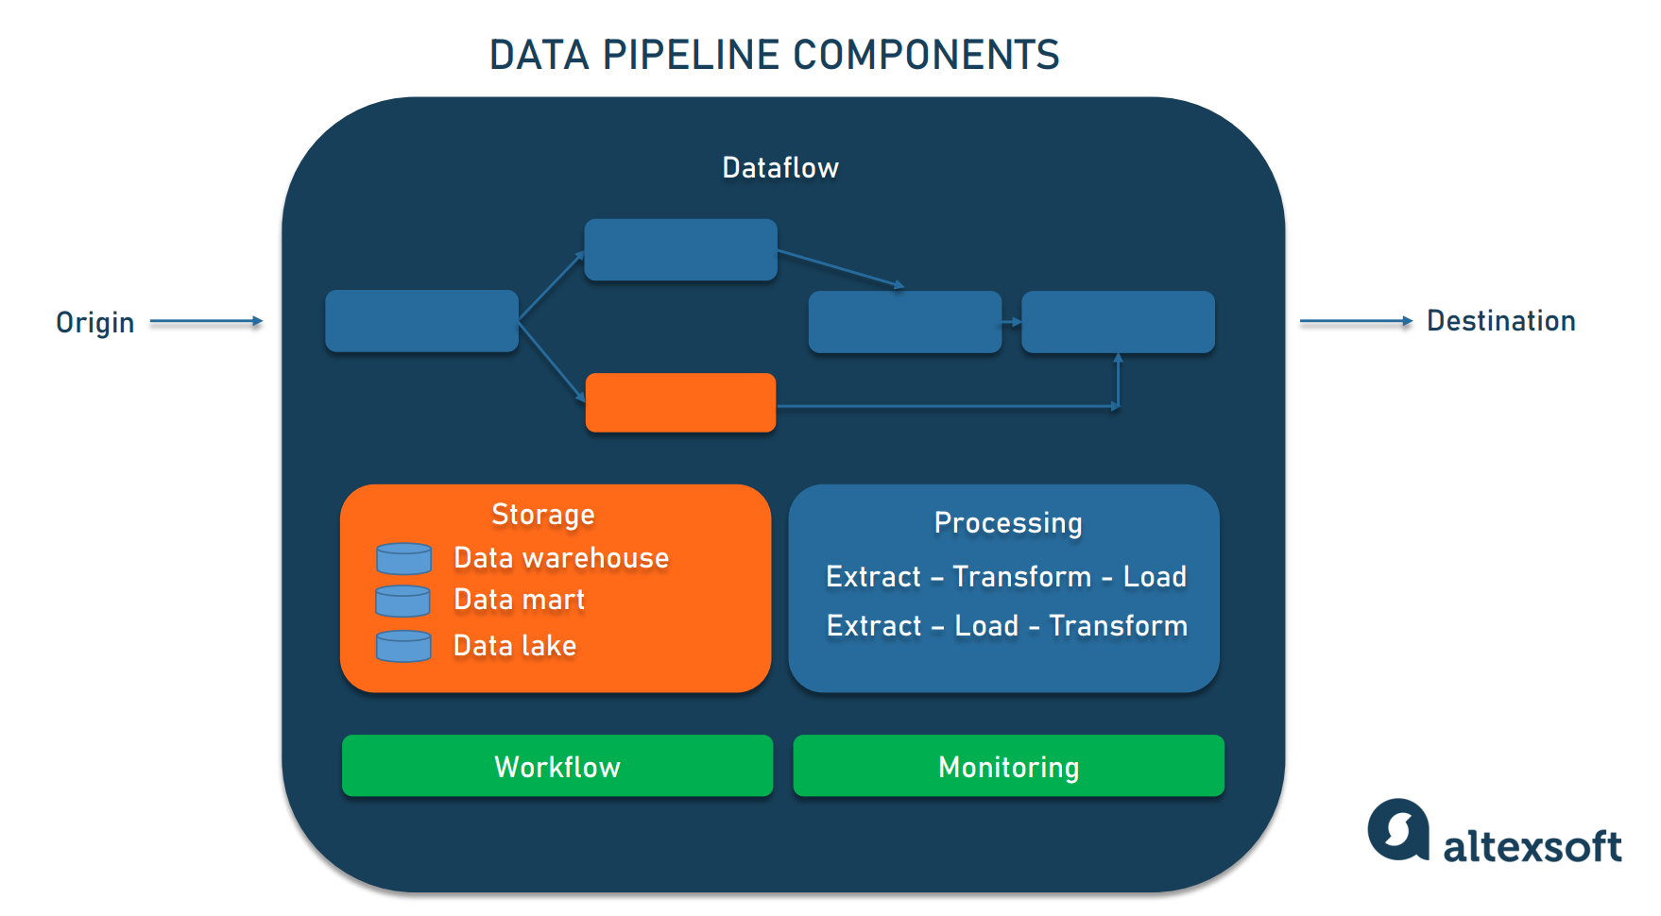
Components
That’s the movement of data from origin to destination, including the changes it undergoes along the way as well as the data stores it goes through.
Storage refers to systems where data is preserved at different stages as it moves through the pipeline.
Processing includes activities and steps for ingesting data from sources, storing it, transforming it, and delivering it to a destination.
The workflow defines a sequence of processes (tasks) and their dependence on each other in a data pipeline. The goal of monitoring is to check how the data pipeline and its stages are working
Origin is the point of data entry in a data pipeline.
The final point to which data is transferred is called a destination.

Slide 59
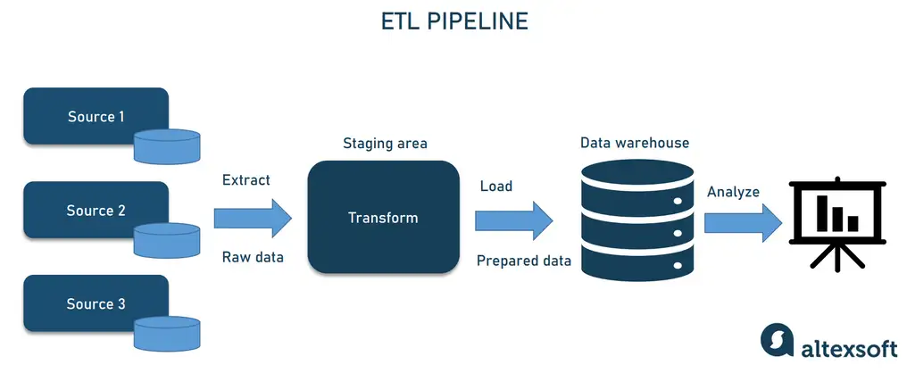
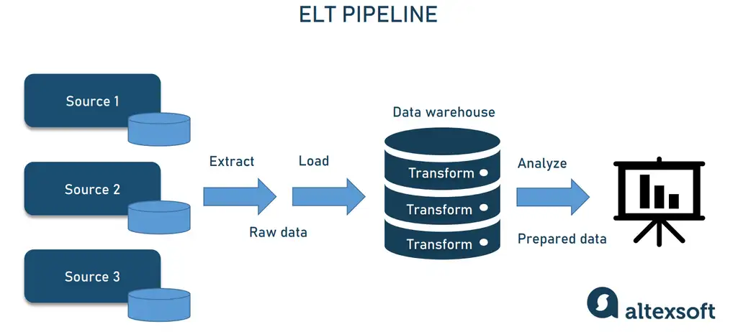
ETL, ELT
Both ETL and ELT are a type of data pipeline architecture

Slide 60
ETL, ELT
The target (e.g., cloud data platform) can handle massive parallel transformations
You want to load raw data quickly for agility
You work with semi-structured / unstructured data
You need data reusability for multiple downstream consumers
Eg:
Data Lake / Lakehouse Pipelines
Machine Learning Pipelines
You need high data quality and governance upfront
The target system (e.g., legacy warehouse) has limited compute/storage
You need structured, curated, analytical data
Transformations are complex or depend on business rules outside the database
Eg:
Enterprise Data warehouse
Regulatory / Compliance Reporting
Master Data Management
ERP to Warehouse Integration
Which is ETL and which is ELT?
ELT
ETL

Slide 61
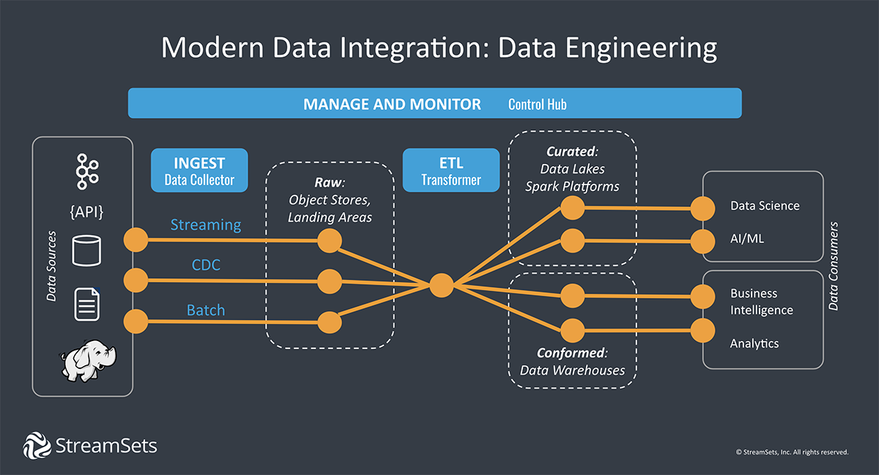
Data Integration Pipeline

Slide 62
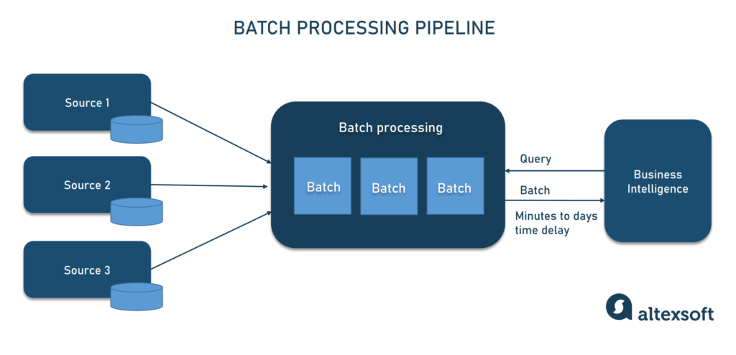
Batch Processing Pipeline
Loads “batches” of data into a repository during set time intervals, which are typically scheduled during off-peak business hours.
The optimal data pipeline when there isn’t an immediate need to analyze a specific dataset (for example, monthly accounting), and it is more associated with the ETL data integration process
Batch processing jobs form a workflow of sequenced commands, where the output of one command becomes the input of the next command.
The development of batch processing was a critical step in building data infrastructures that were reliable and scalable.

Slide 63
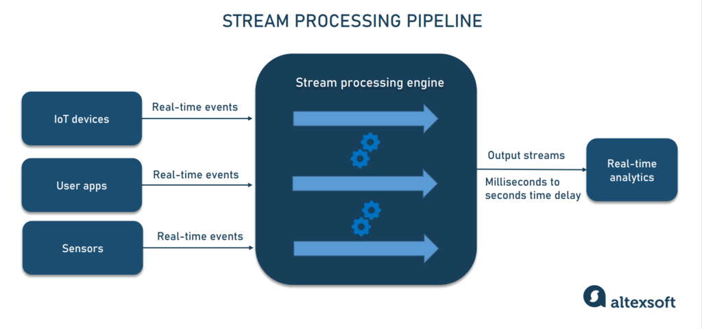
Stream Processing Pipelines
Events are processed and analyzed, and then either stored in databases or sent downstream for further analysis.
Streaming data is leveraged when it is required for data to be continuously updated.
Since data events are processed shortly after occurring, streaming processing systems have lower latency than batch systems, but aren’t considered as reliable as batch processing systems as messages can be unintentionally dropped or spend a long time in queue.
Also known as event-driven architectures—continuously process events generated by various sources, such as sensors or user interactions within an application

Slide 64
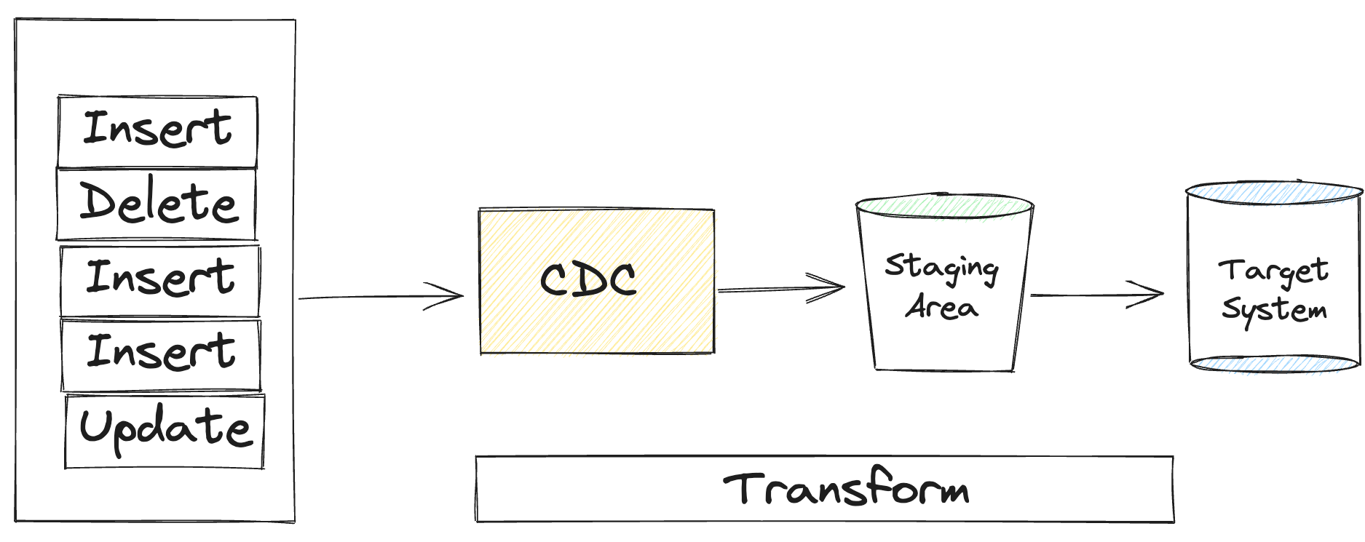
Change Data Capture(CDC)
Scenario: An ecommerce backend service which talks about stocks and stock keeping units. This is continuously used whenever a product is searched from the front end UI(which could be web page or mobile app). These get updated as and when new stock arrive or on customer purchase or return . In case the database is down, they want to bring in the backup or replica database to run without any service interruption and with no or very minimum data loss. How will you achieve this?
A method for extracting each change event(insert, update, delete) that occurs in a DB
RDBMS generates event logs, which can be used for replications
(batch CDC)
Many cloud based NoSQL, can send events (trigger CDC)
Used in these scenarios

Slide 65
Dataflow Model & Unified batch & streaming
One of the central problems of managing batch and stream processing unifying multiple code paths
Kappa – relies on unified queueing and storage layer, but still has to confront using different tools for collecting real-time statistics or running batch aggregation jobs
Google attempted to solve it by Dataflow model and Apache Beam as its implementation
Core idea is to view all data as events, aggregation is performed over various types of windows
Ongoing real-time event streams are unbounded data
Data batches are simply bounded event streams and boundaries provides natural window
Windows can tumbling , sliding
Real-time and batch processing happens in same system using nearly identical code
Philosophy “batch as a special case of streaming” is now more pervasive
Frameworks such as Flink and Spark have adopted a similar approach!

Slide 66
Data Pipeline Implementation

Slide 67
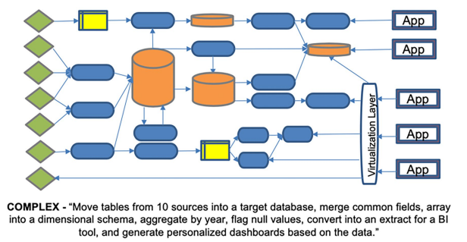

Simple and Complex
Some data pipelines are simple
CSV → Database → Dashboard
Data from CSV files (sales or IoT logs) is ingested daily into a relational database, then visualized in a dashboard.
Simple ETL, ELT
Most are more complex
Eg: Move tables from 10 sources into a target database, merge common fields, array into a dimensional schema, aggregate by year, flag null values, convert into an extract for a BI tool, and generate personalized dashboards based on the data.

Slide 68
Scenarios
A Development Pipeline
creates code to process data for a new pipeline
An Execution Pipeline
runs the pipeline in production
In most IT shops
These are managed by different teams, creating tremendous inefficiencies
Developers can build or change code without being responsible for its downstream impacts
Inevitably increases error rates, delays delivery and frustrates business users

Slide 69
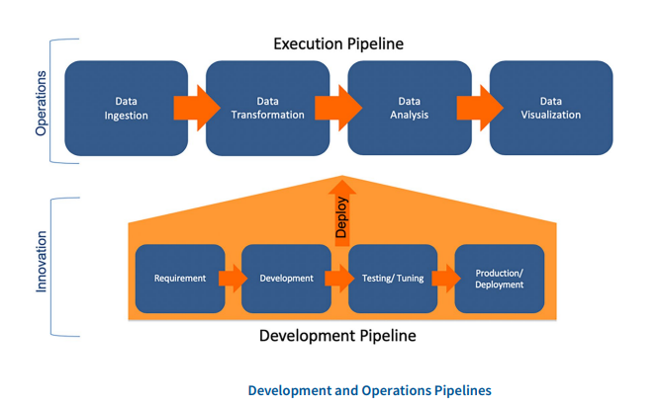
Development and Execution Pipelines

Slide 70
Micro Pipeline
To manage the complexity, it is better to divide individual stages into micro-pipelines
to ensure that changes can be made to each step without disrupting the entire flow
The micro-pipelines consist of the following steps:
Requirement
Agile methods, such as Scrum and Kanban, elicit requirements from stakeholders in an iterative manner
A requirement could be the integration of a new data source in an ETL process or the addition of a new field to a database table
Development
In data and analytics, development does not necessarily mean programming
it can comprise tasks like changing a data model or reconfiguring a dash-board
Requires a high level of automation
e.g., automatically generating database queries when a model is changed, to avoid repetitive manual work

Slide 71
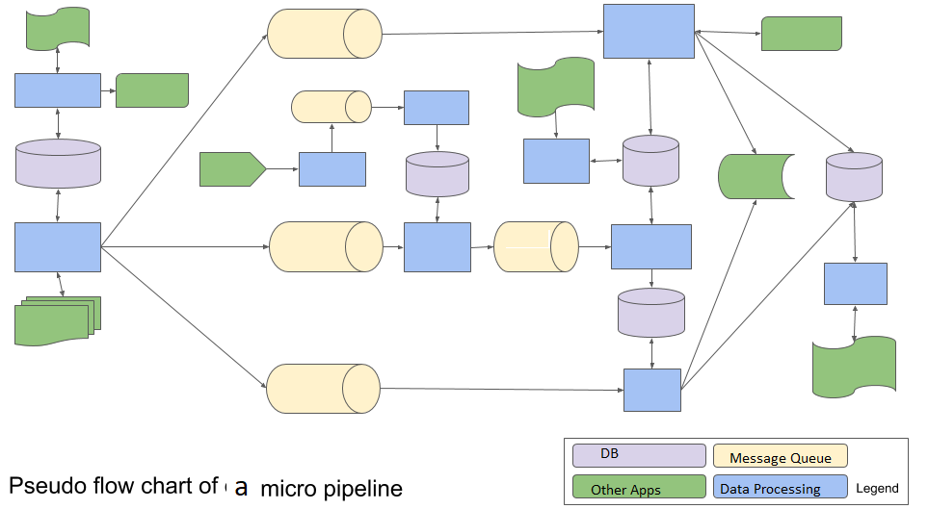
Micro Pipeline - Sample

Slide 72
Data Pipeline Tools / Platforms

Slide 73
Considerations - Overall
Building a single pipeline for a single purpose at a given time is no problem
Can grab a simple tool for setting up a data pipeline or hand code the steps
But how to scale that process to thousands of data pipelines in support of increasing demand for data across organization, over months or years?
When considering data pipeline tools, it is important to think ahead to where your data platform is headed.
Decision Basis
Are we grabbing data from one place to put it somewhere else? Or do you need to transform it to fit the downstream analytics requirements?
Is our data environment stable and fully under your control? Or is it dynamic and pulling data from systems or apps outside of your control?
Will the pipeline move data once, for a short-term analysis project? Or will the pipelines you build need to be operationalized to handle data flows over time?

Slide 74
Data Ingestion and Data Loading Tools
These tools make data pipelines easy to set up, easy to build, and easy to deploy solve the “under construction” issue
But only if you can count on your data scientists to do the data prep work later
Only support the most basic transformations and work best for simply copying data
Instead of being intent-driven, these data pipelines are rigid and embedded with the specifics of data structure and semantics
Instead of adapting to change when data drift happens, they have to be rebuilt and deployed again

Slide 75
Data Integration, Data Transformation Platforms
More complex data integration or ETL software may have a solution for every possible scenario with hundreds of connectors, integrations, and transformations
But these platforms were designed for an era when data drift hardly happened
Things stayed the same for years
At the first hint of change, these data pipelines break and require massive rework
The demands for digital transformation are moving fast and planning for every possible outcome may not be possible

Slide 76
Data Engineering Platforms
A data engineering platform builds smart data pipelines according to DataOps principles
Smart data pipelines abstract away the “how” so you can focus on the what, who, and where of the data
This is the fundamental difference between data integration and data engineering
Instead of being perpetually under construction, out of order, or limited to a single platform
Smart data pipelines allow you to move fast with confidence that your data will continue to flow with little to no intervention
DataOps tools allow us to:
Design and deploy data pipelines in hours, not weeks or months
Build in as much resiliency as possible to handle changes
Adopt to new platforms by pointing to them, a task that takes minutes not months

Slide 77
Use Cases-Contd
Logistics and supply chain optimization
By integrating Fivetran for data ingestion and dbt for transformation, companies can monitor inventory in real time and predict disruptions. This integration can lead to faster fulfillment, reduced costs and improved demand planning in industries such as retail, manufacturing and transportation.
Fraud detection and risk management
Financial institutions and e-commerce platforms use MDS to detect fraud and prevent data breaches. By using ML models, application programming interfaces (APIs) and services such as Amazon Redshift, organizations can identify suspicious transactions and automate fraud detection.

Slide 78
References:
Designing Data Intensive Applications by Martin Kleppmann
https://www.ibm.com/think/topics/data-pipeline
https://medium.com/@andymadson/the-evolution-of-data-pipelines-from-etl-to-elt-and-beyond-2e04deac7062
https://www.infoworld.com/article/2158174/what-is-service-oriented-architecture.html
https://www.altexsoft.com/blog/data-pipeline-components-and-types/
https://underthehood.meltwater.com/blog/2019/07/12/micro-pipelines-analyzing-big-data-with-tiny-apps/
https://www.ibm.com/think/topics/modern-data-stack

Slide 79
Thank You!

